Slide 1


Project name: Kubernetes-based Attacks Team members: Albert M, Patrick C, Thomas G

Slide 2
Problem Statement
The US Navy is using Kubernetes to manage software. However, as a relatively new cyberservice, Kubernetes has a variety of cyber security weaknesses.

Slide 3
Proposal
Develop a scalable Kubernetes testbed that can simulate and defend against common types of attacks.
UPDATE: Will now focus on attacks only.

Slide 4
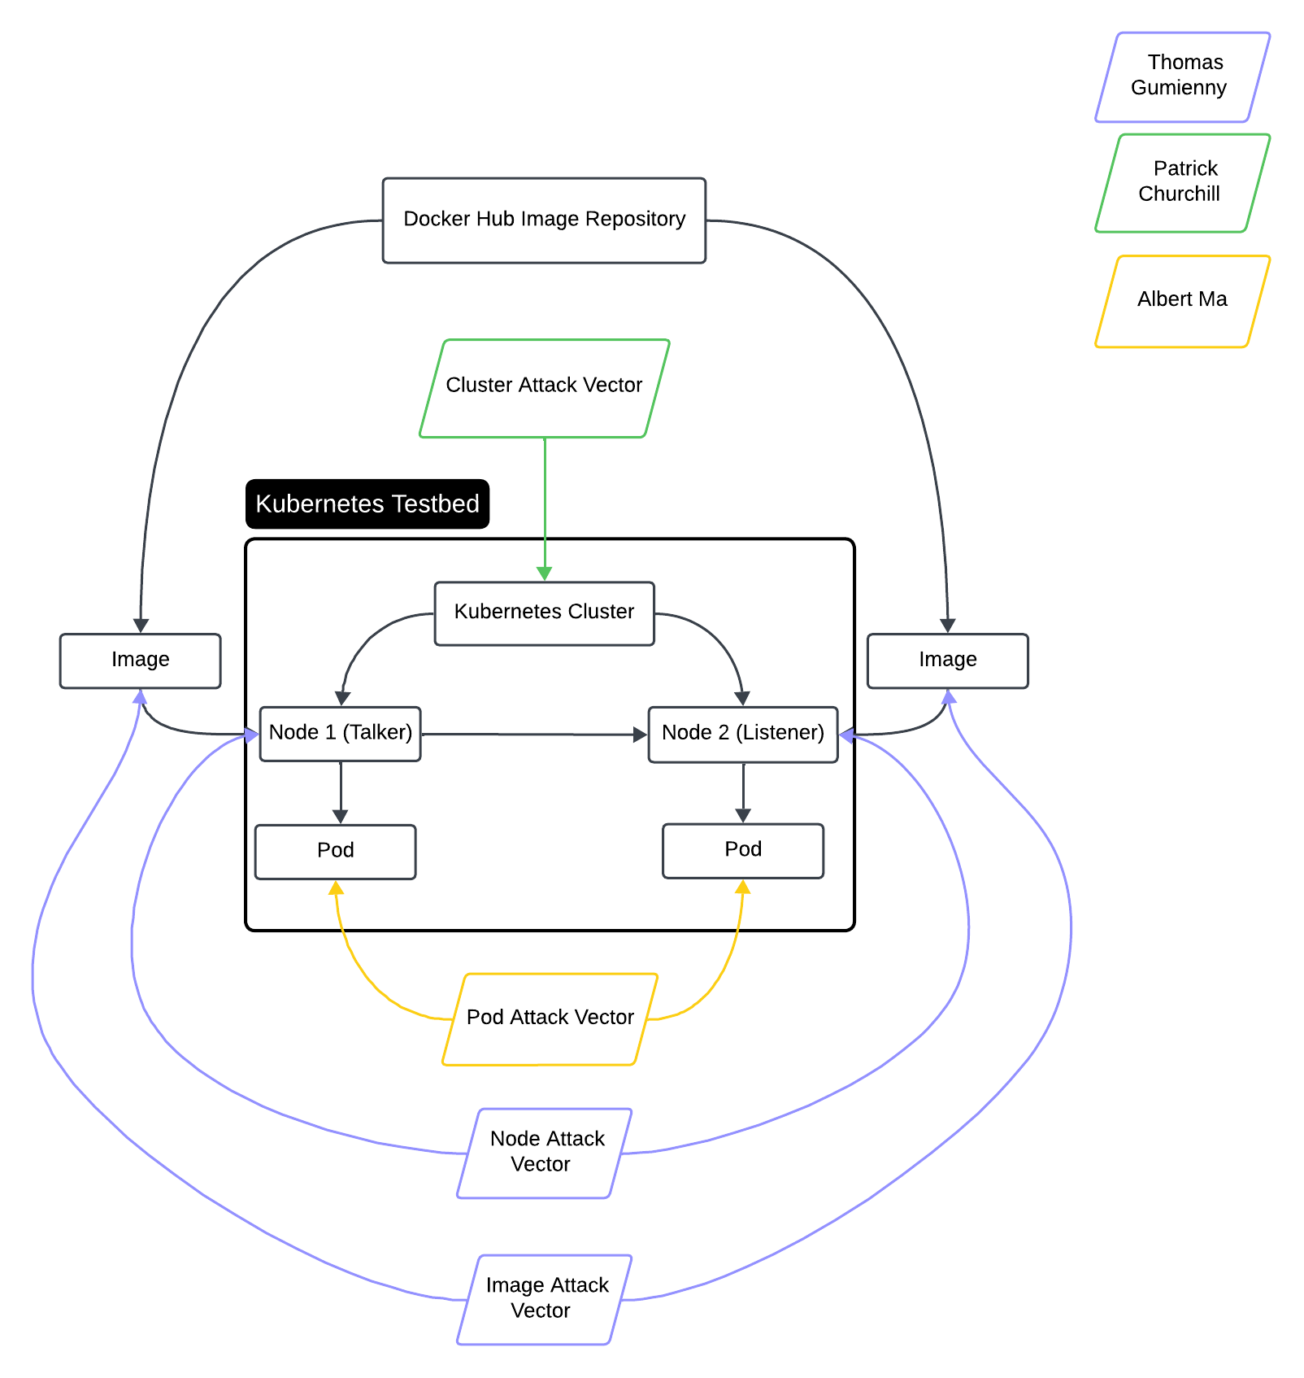
Diagram of Subsystems and Interfaces

Slide 5
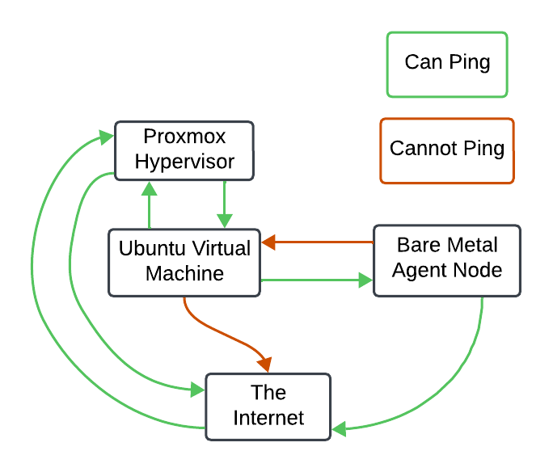
Cluster Setup
Team Project
Accomplishments since the last presentation 27.5 hours | Ongoing progress/problems and plans until the next presentation
-Virtual Machine is set up -Vnet set up -Nodes can communicate | -Virtual Machine Node cannot connect to the internet -Virtual Machine Node cannot be pinged by bare metal node -Work with grad student and Dr. Kim to complete cluster as quickly as possible -Determine software running on nodes so we can build attacks off it

Slide 6
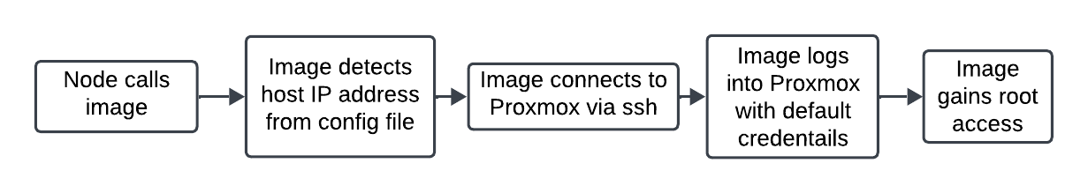
Image/Node Attacks
Thomas Gumienny
Accomplishments since the last presentation 5 hours | Ongoing progress/problems and plans until the next presentation
-Literature review -DNStwist used for generating typosquatting names -Proxmox privilege escalation flaw found | -Adapt code to software running on cluster -Generate similar image names using DNStwist -Use code to gain control of node.

Slide 7
Cluster Attacks
Patrick Churchill
Accomplishments since the last presentation 4 hours | Ongoing progress/problems and plans until the next presentation
Reviewed articles on how to implement attack vectors Planned both directions of attack(pulling info and disrupting functions) | Having nodes communicate so that we can test attack vectors Correctly implement attack vectors without breaking system

Slide 8
Pod Attacks
Albert Ma
Accomplishments since the last presentation 4 hours | Ongoing progress/problems and plans until the next presentation
Literature review on how pods can be used in attacks Ideations for how a malicious pod can be configured, or how vulnerabilities of a pod can be exploited | Develop a draft attack program that targets the pod whilst the cluster is being configured (This doesn’t necessarily require an entire cluster but an individual node and pod)
Call eBPF Trace/Call
Target Container
Return PIDs and UIDs for all processes
Gain full control of pod
Extra commands/Malicious returns to bash script

Slide 9
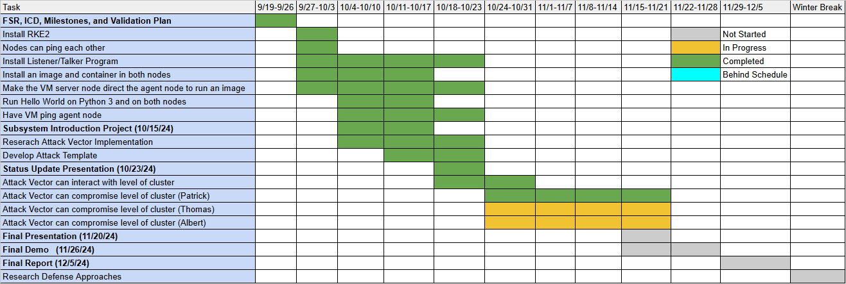
Execution plan

Slide 10
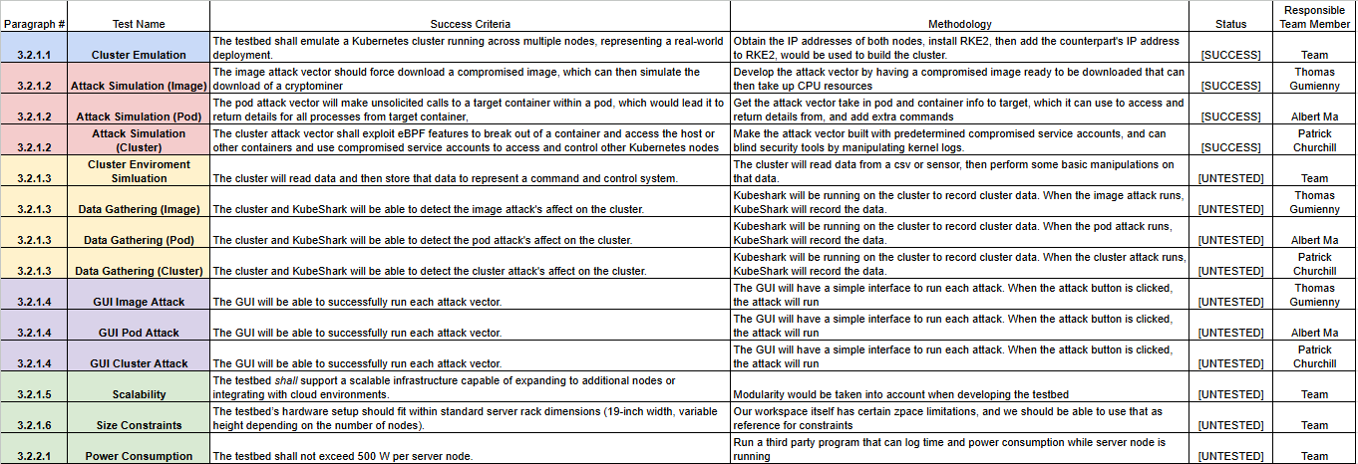
Validation plan

